Slide 1
Workshop HSLU – Hands-on
Cognitive IoT Application

Slide 2
Content
0. Description of the Exercise
Set Up your Chatbot
Integrate your Chatbot on your RaspberryPi
Build a Cognitive IoT Application

Slide 3
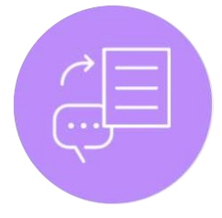
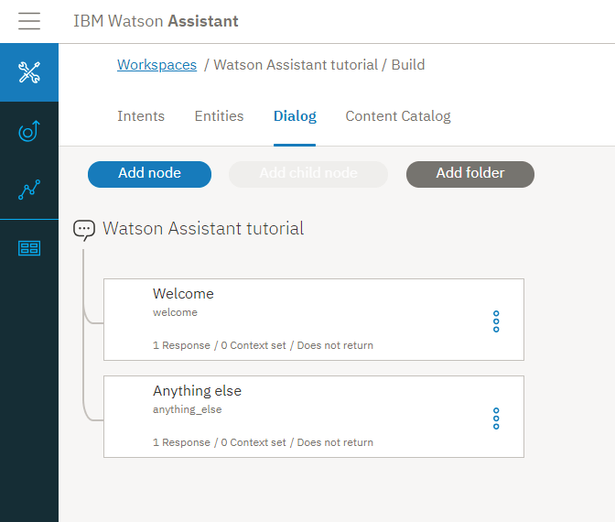


0. Description of the Exercise
User-View
1
2
Speech to Text (Optional)
3 + 4
5
User:
- Input (Text/Voice) - Output (Text/Audio)
Gateway = RPi
Watson Assistant

Slide 4
1. Set Up your Chatbot
Navigate to the folder: → «Additional-Cloud-Exercises» → Lab 03 Watson Assistant
Open the .pdf «Lab 03 Watson Assistant»
Follow the steps 1-69
Bravo! You have set up your first chatbot!

Slide 5
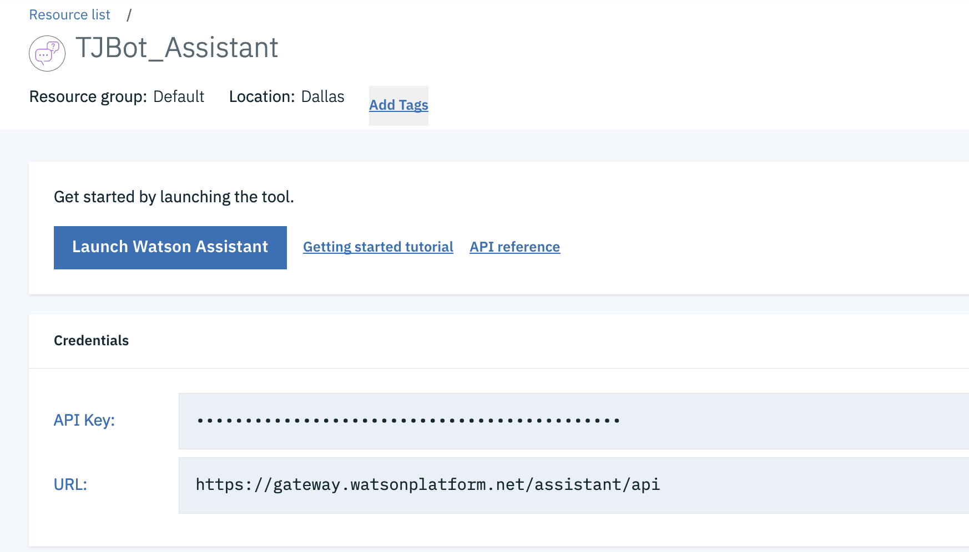
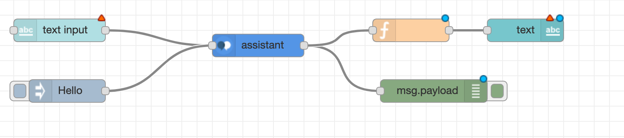
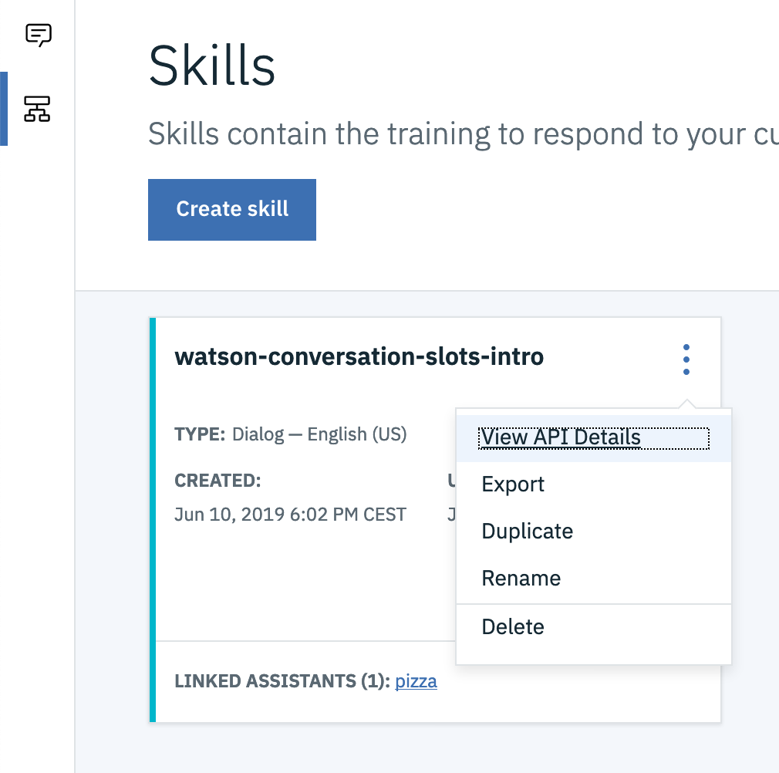
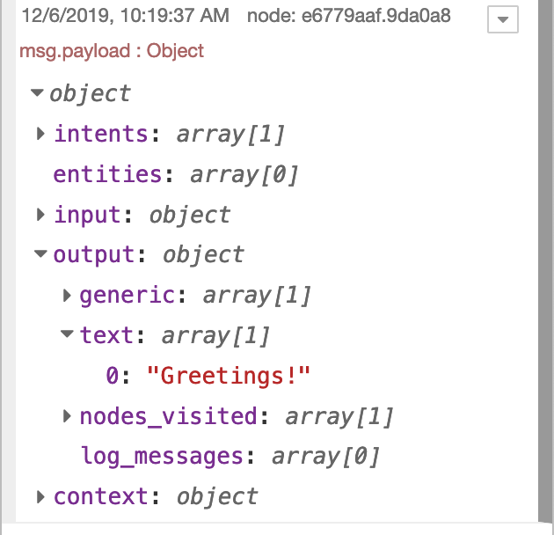
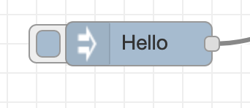
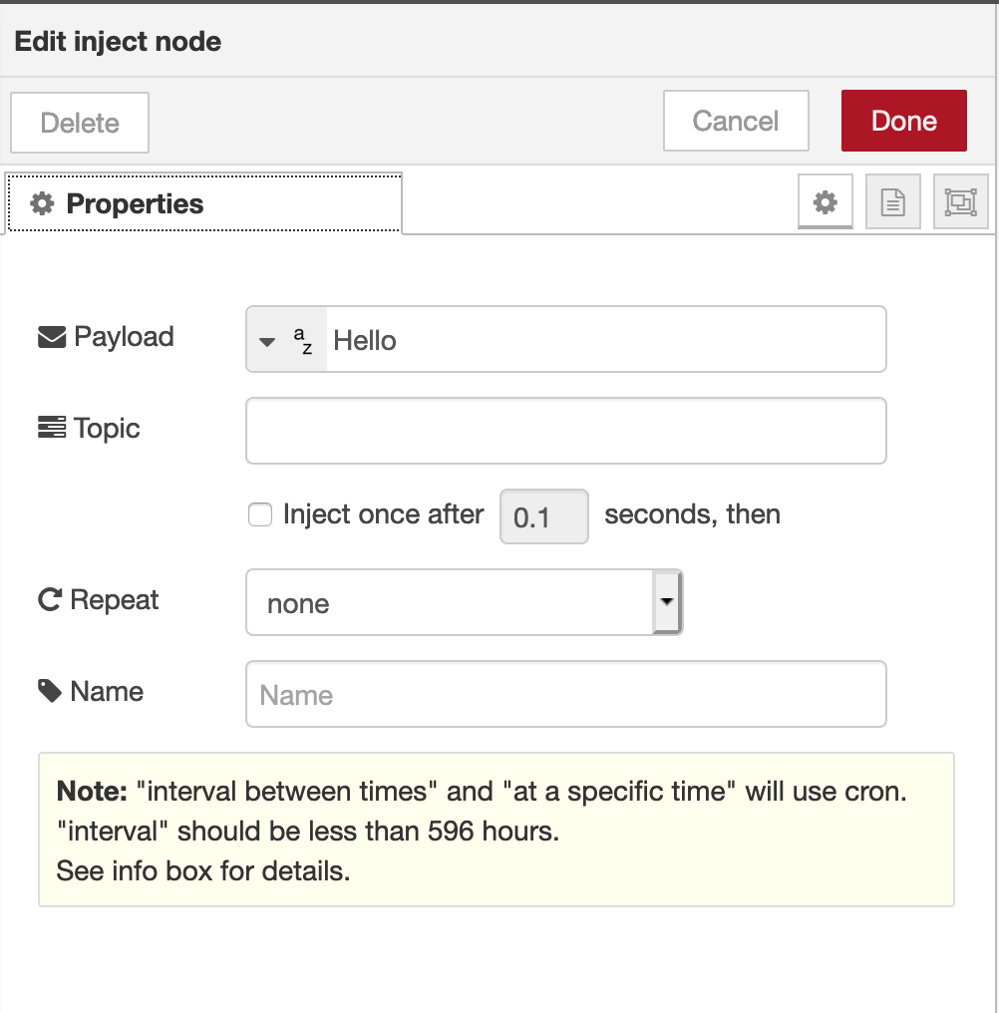

2. Integrate your Chatbot on your RaspberryPi
Open NodeRed and create the following flow
Open the Watson Assistant Node and try to configure with the credentials from the Watson Assistant Tool → Hint: You find the API key in the IBM Cloud → Hint: You find API Details in the Watson Assistant Tool
Test it by sending “Hello” in the inject node. Click on the button left to the inject node. Check the in the Debug section the output.

Slide 6
3. Build a Cognitive IoT Application
Configure the UI nodes to build a frontend
Instead of using Text Input try to use your voice and the «Speech to text Service»
Add a a new intend to turn in the Watson Assistant Tool to turn servo motor.

